Slide 1
Question 1 Which of the following artifacts can be examined by using review techniques?
a. Software code
b. Requirements specification
c. Test designs
d. All of the above
Question 2 Which statement about the function of a static analysis tool is true?
Gives quality information about the code without executing it.
Checks expected results against actual results.
c. Can detect memory leaks.
d. Gives information about what code has and has not been exercised.

Slide 2
Question 3 Which is not a type of review?
Walkthrough
Inspection
Informal review
Management approval
Question 4 What statement about reviews is true?
a. Inspections are led by a trained moderator, whereas technical reviews are not necessarily.
b. Technical reviews are led by a trained leader, inspections are not.
c. In a walkthrough, the author does not attend.
d. Participants for a walkthrough always need to be thoroughly trained.

Slide 3
Question 5 What is the main difference between a walkthrough and an inspection?
a. An inspection is led by the authors, whilst a walk through is led by a trained moderator.
b. An inspection has a trained leader, whilst a walk through has no leader.
c. Authors are not present during inspections, whilst they are during walkthroughs.
d. A walkthrough is led by the author, whilst an inspection is led by a trained moderator.
Question 6 Which of the following characteristics and types of review processes belong together?
1. Led by the author
2. Undocumented
3. No management participation
4. Led by a trained moderator or leader
s. Inspection
t. Technical review
u. Informal review
v. Walkthrough
a. s = 4, t = 3, u = 2 v = 1 b.
b. s = 1, t = 3, u = 2, v = 4
c. s = 2, t = 4, u = 3, v = 1 and 2

Slide 4
Question 7 Which of the following statements about early test design are true and which are false?
1. Defects found during early test design are more expensive to fix.
2. Early test design can find defects.
3. Early test design can cause changes to the requirements.
4. Early test design takes more effort.
a. 1 and 3 are true. 2 and 4 are false.
b. 2 is true. 1, 3 and 4 are false.
c. 2 and 3 are true. 1 and 4 are false.

Slide 5
Dynamic Testing
Black-Box and White-Box Techniques

Slide 6
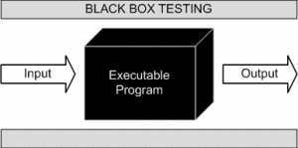
Black Box Testing Functional / Behavioral Testing

Slide 7
This method attempts to find errors in the following categories:
Incorrect or missing functions
Interface errors
Errors in data structures or external database access
Behavior or performance errors
Initialization and termination errors

Slide 8
Equivalence Partitioning
Specification-based Black-Box technique
only one condition from each partition

Slide 9
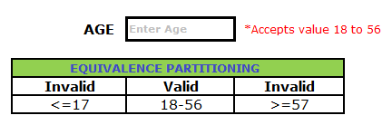
Example 1:
Assume, we have to test a field which accepts Age 18 – 56
Valid Input: 18 – 56
Invalid Input:less than or equal to 17 (<=17), greater than or equal to 57 (>=57)
Valid Class: 18 – 56 = Pick any one input test data from 18 – 56
Invalid Class 1: <=17 = Pick any one input test data less than or equal to 17
Invalid Class 2: >=57 = Pick any one input test data greater than or equal to 57
We have one valid and two invalid conditions here.

Slide 10
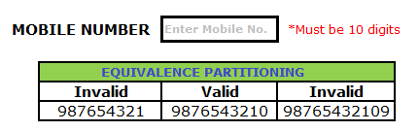
Example 2:
Assume, we have to test a file which accepts a Mobile Number of ten digits.
Valid input: 10 digits
Invalid Input: 9 digits, 11 digits
Valid Class: Enter 10 digit mobile number = 987653210
Invalid Class Enter mobile number which has less than 10 digits = 987654321
Invalid Class Enter mobile number which has more than 11 digits = 98765432109

Slide 11
Assignment
Consider a software module that is intended to accept the name of a grocery item and a list of the different sizes the item comes in, specified in ounces.
Specification :
The item name is to be alphabetic characters 2 to 15 characters in length.
Each size may be a value in the range of 1 to 48, whole numbers only.
The sizes are to be entered in ascending order.
A maximum of five sizes may be entered for each item.
The item name is to be entered first, followed by a comma, then followed by a list of sizes. A comma will be used to separate each size.
Spaces (blanks) are to be ignored anywhere in the input.

Slide 12
Derived Equivalence Classes (Sample)
Item name is alphabetic (valid)
Item name is not alphabetic (invalid)
.
.
.
Equivalence Partitioning Table
# | Test Data | Expected Outcome | Classes Covered
3 | a2x,1 | F | 2

Slide 13
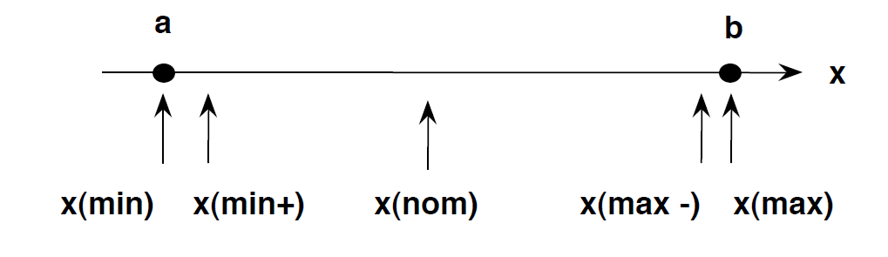
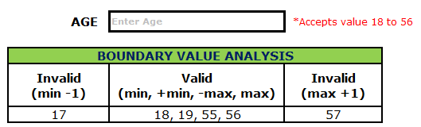
Boundary Value Analysis
Boundary testing is the process of testing between extreme ends or boundaries between partitions of the input values.
So these extreme ends like Start- End, Lower- Upper, Maximum-Minimum, Just Inside-Just Outside values are called boundary values and the testing is called "boundary testing".
The basic idea in boundary value testing is to select input variable values at their:
Minimum
Just above the minimum
A nominal value
Just below the maximum
Maximum

Slide 14
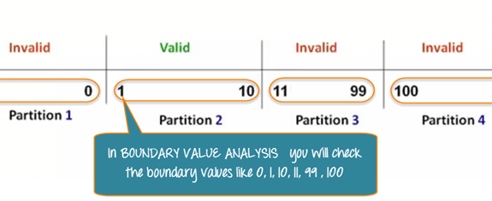
Example 1: Equivalence and Boundary Value
Let's consider the behavior of tickets in the Flight reservation application, while booking a new flight.
Ticket values 1 to 10 are considered valid & ticket is booked.
While value 11 to 99 are considered invalid for reservation and error message will appear, "Only ten tickets may be ordered at one time."
Here is the test condition
Any Number greater than 10 entered in the reservation column (let say 11) is considered invalid.
Any Number less than 1 that is 0 or below, then it is considered invalid.
Numbers 1 to 10 are considered valid
Any 3 Digit Number say -100 is invalid.

Slide 15
Example 2: Equivalence and Boundary Value
Suppose a password field accepts minimum 6 characters and maximum 10 characters
Test # | Test Scenario Description | Expected Outcome
1 | Enter 0 to 5 characters in password field | System should not accept
2 | Enter 6 to 10 characters in password field | System should accept
3 | Enter 11 to 14 character in password field | System should not accept

Slide 16
Decision table testing
Otherwise called as Cause-Effect Table
To check combination of Input

Slide 17
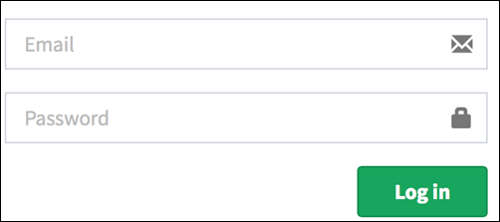
Legend:
T – Correct username/password
F – Wrong username/password
E – Error message is displayed
H – Home screen is displayed
Interpretation:
Case 1 – Username and password both were wrong. The user is shown an error message.
Case 2 – Username was correct, but the password was wrong. The user is shown an error message.
Case 3 – Username was wrong, but the password was correct. The user is shown an error message.
Case 4 – Username and password both were correct, and the user navigated to homepage
Conditions | Rule 1 | Rule 2 | Rule 3 | Rule 4
Username (T/F) | F | T | F | T
Password (T/F) | F | F | T | T
Output (E/H) | E | E | E | H

Slide 18
Assignment
If you are a new customer opening a credit card account,
you will get a 15% discount on all your purchases today.
If you are an existing customer and you hold a loyalty card,
you get a 10% discount.
If you have a coupon, you can get 20% off today
(but it can't be used with the 'new customer' discount).
Discount amounts are added, if applicable.

Slide 19
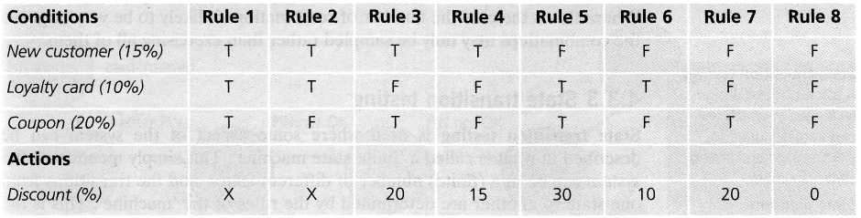

Slide 20
State transition testing
State transition testing is used where some aspect of the system can be described in what is called a 'finite state machine'.
For example, if you request to withdraw $100 from a bank ATM, you may be given cash. Later you may make exactly the same request but be refused the money (Why ?)
A state diagram can represent a model from the point of view of the system, the account or the customer.

Slide 21
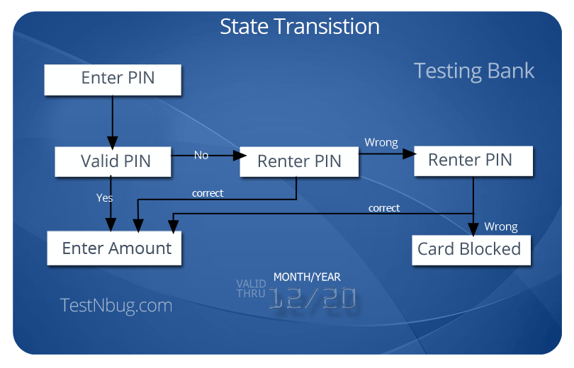

Slide 22
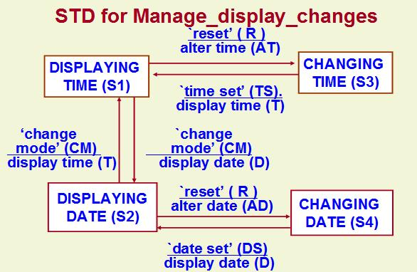


States :
Display Time(S1),
Change Time(S3),
Display Date(S2) and
Change Date (S4).
Inputs :
Change Mode(CM),
Reset (R),
Time Set(TS),
Date Set(DS).
Outputs are
Alter Time(AT),
Display Time(T),
Display Date(D),
Alter Date (AD).

Slide 23
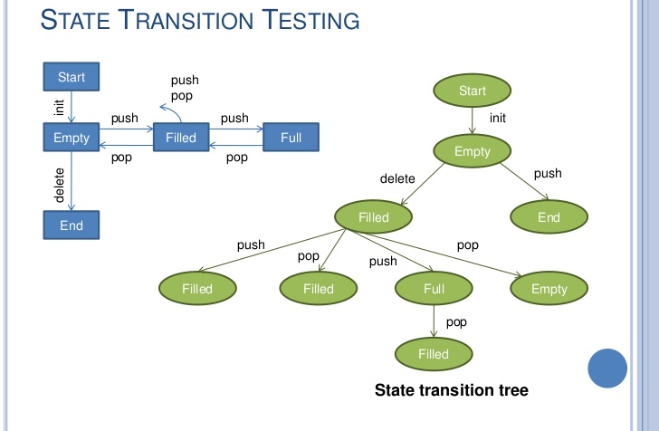
STACK OPERATIONS
States :
Empty (S1),
Partially Filled(S2),
Full (S3) and
End (S4)
Inputs :
Push
Pop
Outputs are
Print Stack (S)
Print Error Msg (E)
Start | S1 | S1 | S2 | S2 | S2 | S2 | S3 | S3
Input | Push | POP | Push | Push | Pop | Pop | Push | Pop
Output | S | E | S | S | S | S | E | S
Finish | S2 | S4 | S2 | S3 | S2 | S1 | S4 | S2

Slide 24
A state transition model has four basic parts:
• the states that the software may occupy (open/closed or funded/insufficient funds);
• the transitions from one state to another (not all transitions are allowed);
• the events that cause a transition (closing a file or withdrawing money);
• the actions that result from a transition (an error message or being given your cash).

Slide 26
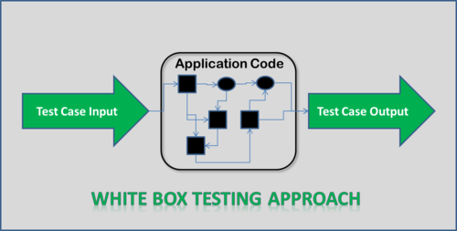
White Box Testing - Structural Testing
Also known as Glass Box testing
Internal structure/design/implementation of the item being tested is known to the tester.

Slide 27
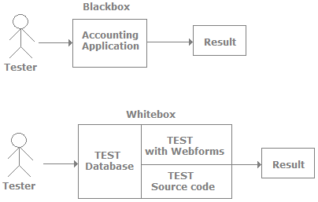

Slide 28
White Box Testing Techniques
Statement Coverage
Branch Coverage
Path Coverage

Slide 29
Statement Testing and Coverage
This analysis focuses on each statement of the test object.
The test cases execute all statements of the test object.
The first step is to translate the source code into a control flow graph.
If(condition)
If(condition)
Do
Set of statements
While(condition)
Endif
Endif
Print statement
end

Slide 30
Statement Coverage
a, b, f, g, h, d, e
Branch Coverage
a, b, c, d, e
a, b, f, g, h, d, e
a, b, f, g, i, g, h, d, e
a, k, e
Test Exit Criteria
Statement coverage =(no of executed statements / total no of statements) 100%
Branch coverage = (no of executed branches / total no of branches) × 100%

Slide 31
Path Testing
Statement Testing and Branch Testing – Not sufficient for programs with loops
Usually a loop is repeated more than once. Further possible sequences of branches through the graph of the program are as follows:
a, b, f, g, i, g, i, g, h, d, e
a, b, f, g, i, g, i, g, i, g, h, d, e
a, b, f, g, i, g, i, g, i, g, i, g, h, d, e

Slide 32
Assignment – 8/50
Observe the following code and Perform the following.
Create a Control Flow Graph
Create Test cases for Statement Coverage, Branch Coverage
if (extras >= 3)
addon_discount = 10;
else if (extras >= 5)
addon_discount = 15;
else addon_discount = 0;
if (discount > addon_discount)
addon_discount = discount;
result = baseprice/100.0*(100-addon_discount);
return (result);

Slide 33
Statement Coverage
a, b, c, j, k, l, n
a, d, e, f, i, j, k, l, n
a, d, g, h, i, j, k, l, n
Branch Coverage
a, b, c, j, m, n

Slide 34
Assignment – 8/50
1. Compare Black-Box Testing and White-Box Testing
2. Draw a flow chart for the given pseudocode and design test cases which will cover the entire path
Consider this pseudocode:
INPUT A & B
C = A + B
IF C>100
PRINT “ITS DONE”
END IF
IF A>50
PRINT “ITS PENDING”
END IF

Slide 35
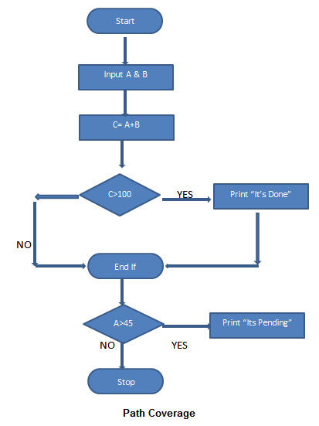
Design test cases which will cover the entire path
TestCase_01: A=50, B=60
TestCase_02: A=55, B=40
TestCase_03: A=40, B=65
TestCase_04: A=30, B=30

